Slide 1

Authentication & Authorization
Branislav Abadjimarinov
National Academy for Software Development
academy.devbg.org

Slide 2

Contents
Basic principles
Authentication Types
  Windows
  Forms
Users & Roles
Membership
  Controls

Slide 3
Basics
Authentication
  The process of verifying the identity
  of a user or computer
Authorization
  The process that determines what a user is permitted to do on a computer system or network

Slide 4
Basics (2)
Cookie
  A small text file created by a web site to store information on your computer
Persistent cookie
  Can be read by the Web site that created
  it when you visit that site again
Temporary (session) cookie is
  Stored only for your current browsing session
  Deleted when you close the browser

Slide 5
Authentication Types
Windows Authentication
  Uses the security features integrated
  into the Windows NT / Windows XP operating systems
Forms authentication
  Code associated with a Web form handles users authentication
  Users list is stored and used by the form

Slide 6
Windows Authentication
Web application use the same security scheme that applies to your network
Network resources and Web applications use the same:
  User names
  Passwords
  Permissions
The default authentication when new web site is created

Slide 7
Windows Authentication (2)
The user is authenticated against his username and password in the OS
When a user is authorized:
  ASP.NET issues an authorization certificate (a cookie)
  Application executes using the permissions found in your account
  The user's session ends when the browser closes or when the session times out

Slide 8
Windows Authentication (3)
Users who are logged on to the network
  Are automatically authenticated
  Can access the Web application
To set the authentication to Windows add to the Web.config
To deny anonymous users add
<authentication mode="Windows" />
<authorization>
<deny users="?"/>
</authorization>

Slide 9
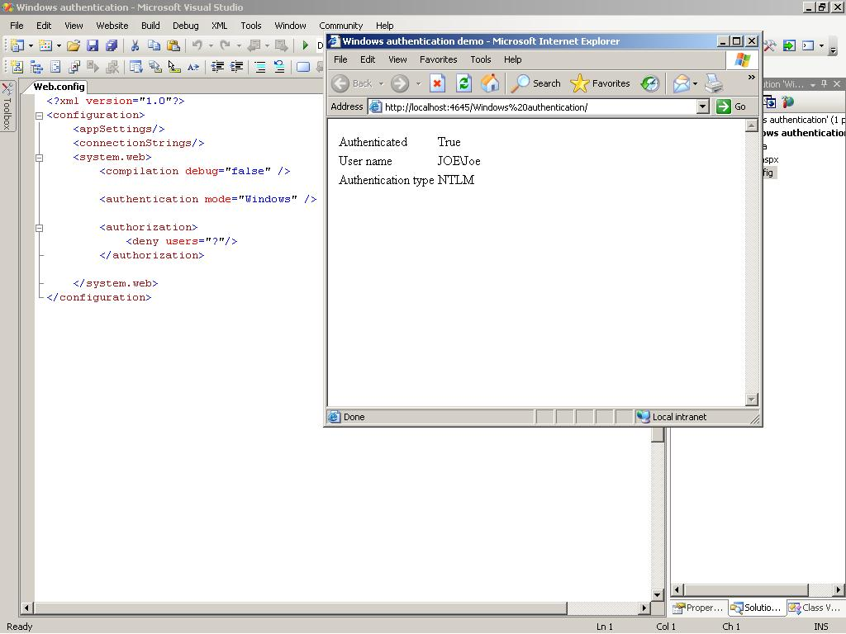
Demo-1-Windows authentication

Slide 10
Forms Authentication
Displays Web form to collect user name and password information
Users are authenticated by the code associated with the Web form
Users list is stored in the application's:
  Web.config file
  Separate user database
The user don't have to be member of
the network

Slide 11
Forms Authentication (2)
Enabling forms authentication:
  Set authentication mode in the Web.config to forms
  Create a Web form to collect logon information
  Create a file or database to store user names and passwords
  Write code to authenticate users against the users file or database
<authentication mode="Forms" />

Slide 12
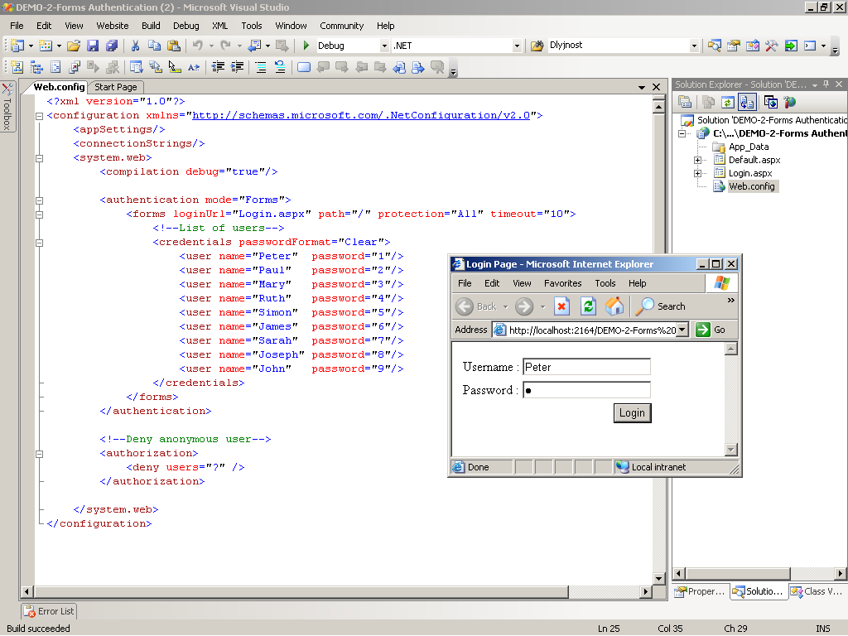
Demo-2-Forms authentication

Slide 13
Roles
The actions and activities that are
  Assigned
  Expected
  Required
  to a person or group
The roles usually determine the level of access of the user account
A user account can be assigned with multiple roles

Slide 14
Roles (2)
Permissions can be granted to multiple users sharing the same role

Slide 15
Security Providers
Membership provider
  Helps to simplify common authentication tasks
    CreateUser
    DeleteUser
    GeneratePassword
    ValidateUser

Slide 16
Security Providers (2)
Role providers
  Helps to simplify common authorization tasks
    CreateRole
    IsUserInRole
    GetAllRoles
    GetRolesForUser

Slide 17
Membership provider
Adding membership provider to the Web.config
<membership defaultProvider="MyProvider">
<providers>
<add connectionStringName="MyConection"
minRequiredPasswordLength="6"
requiresQuestionAndAnswer="true"
enablePasswordRetrieval="false"
requiresUniqueEmail="false"
applicationName="/MyApp"
minRequiredNonalphanumericCharacters="1"
name="MyProvider"
type="System.Web.Security.SqlMembershipProvider"/>
</providers>
</membership>

Slide 18
Enabling Roles
To enable roles in ASP.NET 2.0 add to the Web.config file:
We also add role provider to manage the roles
<roleManager enabled="true" defaultProvider="MyProvider">
<providers>
<add connectionStringName="MyConection"
name="MyProvider"
type="System.Web.Security.SqlRoleProvider" />
</providers>
</roleManager>

Slide 19
aspnet_regsql.exe
The ASP.NET SQL Server Registration tool is used to create a Microsoft SQL Server database for use by the SQL Server providers in ASP.NET
The aspnet_regsql.exe utility that is installed with ASP.NET 2.0 is in:
  C:\WINDOWS\Microsoft.NET\Framework\
  v2.0.50727\aspnet_regsql.exe

Slide 20
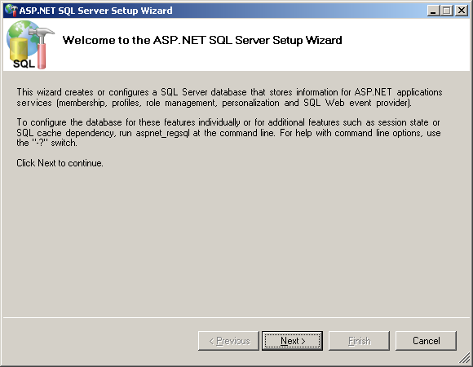
aspnet_regsql.exe –
Live Demo

Slide 21
ASP.NET Web Site Administration Tool
Designed to manage your Web site configuration
Simple interface
Can create and manage users, roles and providers
Can manage application configuration settings
Accessible through Website menu → ASP.Net Configuration

Slide 22
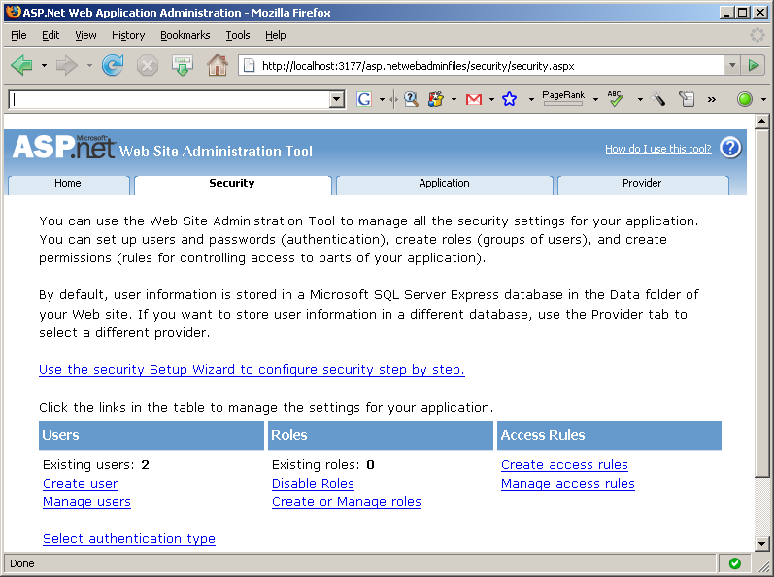
Administration Tool – Live Demo

Slide 23
The Login Control
The Login control provides the necessary interface through which a user can enter their username and password
The control uses the membership provider specified in the Web.config file
Adding the login control to the page:
<asp:Login id="MyLogin" runat="server"/>

Slide 24
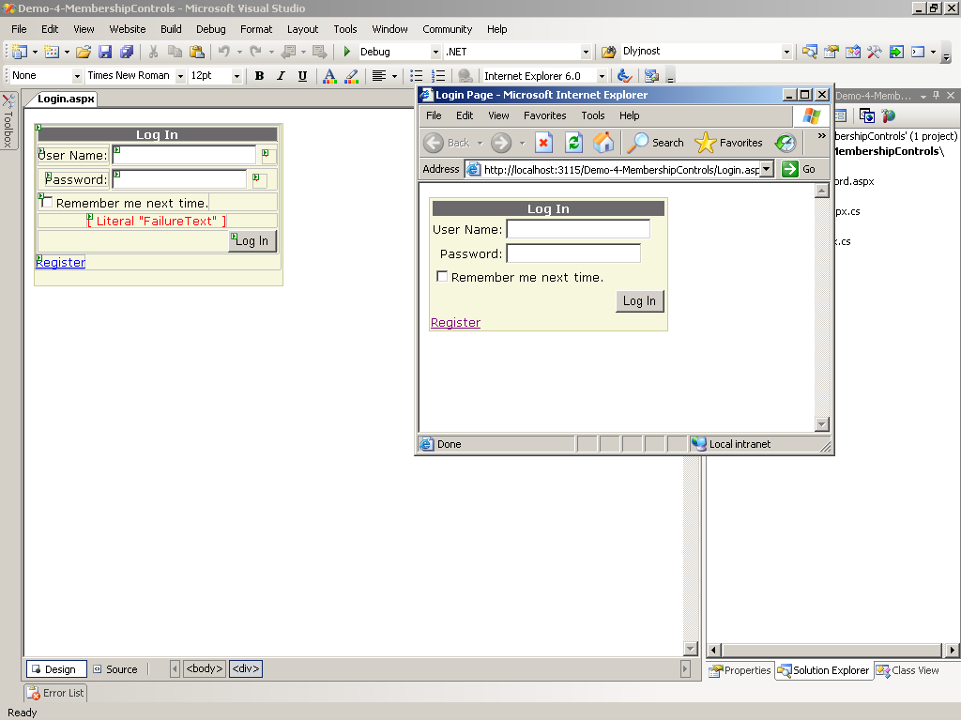
The Login Control

Slide 25
The LoginName and LoginStatus Control
Once the user has logged in we can display his username just by adding the LoginName control to the page
The LoginStatus control allows the user to log in or log out of the application
<asp:LoginName id="lnUser" runat="server"/>
<asp:LoginStatus id=" lsUser" runat="server"/>

Slide 26
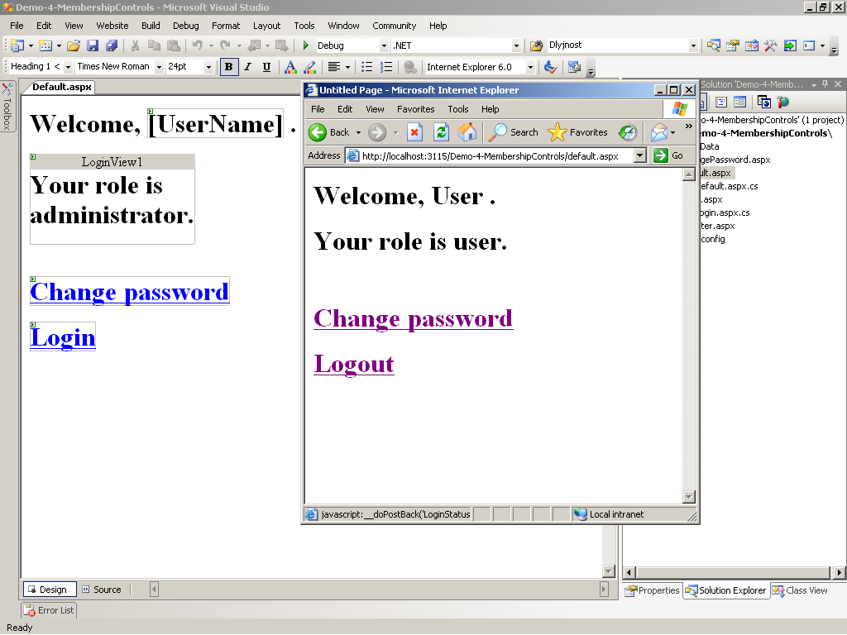
The LoginName and LoginStatus Control

Slide 27
The LoginView Control
Customized information which will be shown to users through templates, based on their roles
By default there are AnonymousTemplate and LoggedInTemplate
New custom templates can be added
To add the control to the page use:
<asp:LoginView id="MyLoginView" runat="server">
</asp:LoginView>

Slide 28
The CreateUserWizard Control
It is used to create new accounts
It works with the membership provider class
Offers many customizable features
Can quickly be added to and used using
<asp:CreateUserWizard id="NewUserWiz" runat="server">
</asp:CreateUserWizard>

Slide 29
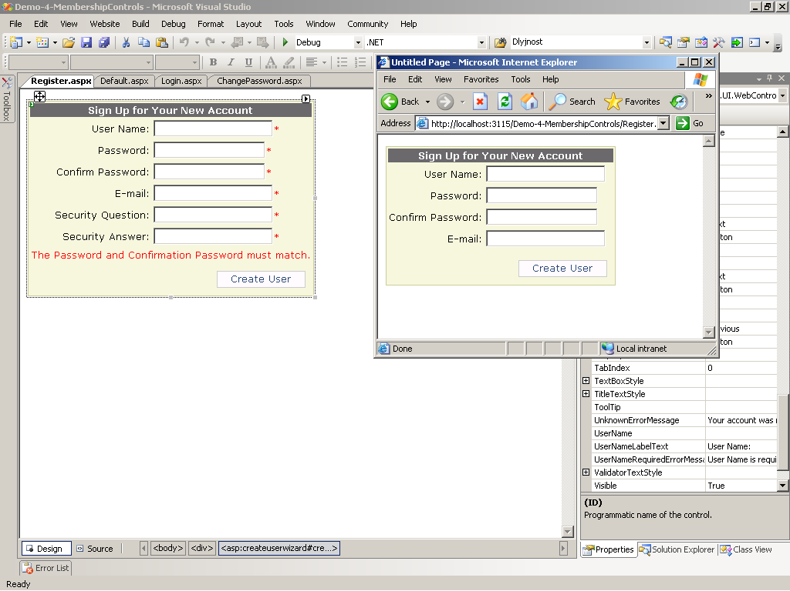
The CreateUserWizard Control

Slide 30
The PasswordRecovery Control
It is used to retrieve passwords
The user is first prompted to enter username
Once users enter valid user names, they must answer their secret questions
The password is sent via e-mail
To add this control use:
<asp:PasswordRecovery id="prForgotPass" runat="server">
</asp:PasswordRecovery>

Slide 31
The ChangePassword Control
Allows users to change their passwords
It uses the membership provider specified in the web.config
Can be added to any page with the following tag:
<asp:ChangePassword id="cpChangePass" runat="server"/>

Slide 32
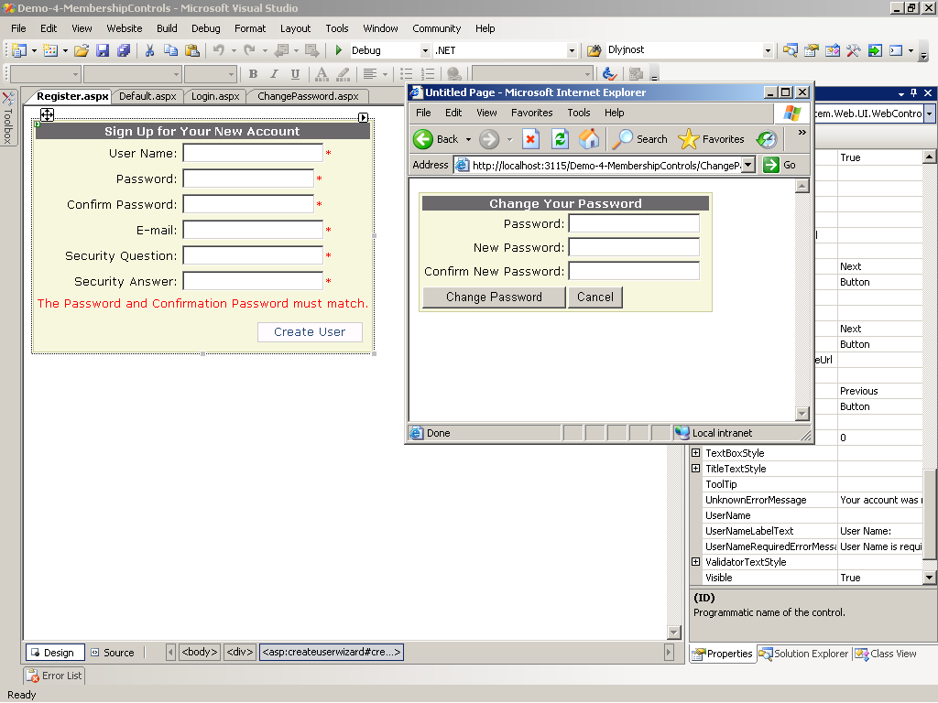
The ChangePassword Control

Slide 33
Authentication & Authorization
Questions?

Slide 34
Exercises
Using the ASP.Net Web Site Configuration Tool create a new role "Student" and two users that have the new role. Create a login page and try to enter the site with one of these two accounts.
Restrict access to a site for unregistered users, hide and show functionality based on user's role.
Create your own membership provider that uses a database of your choice. Change the previous web site to use the new provider. Try to access it with created "Student"
accounts.

